Slide 1
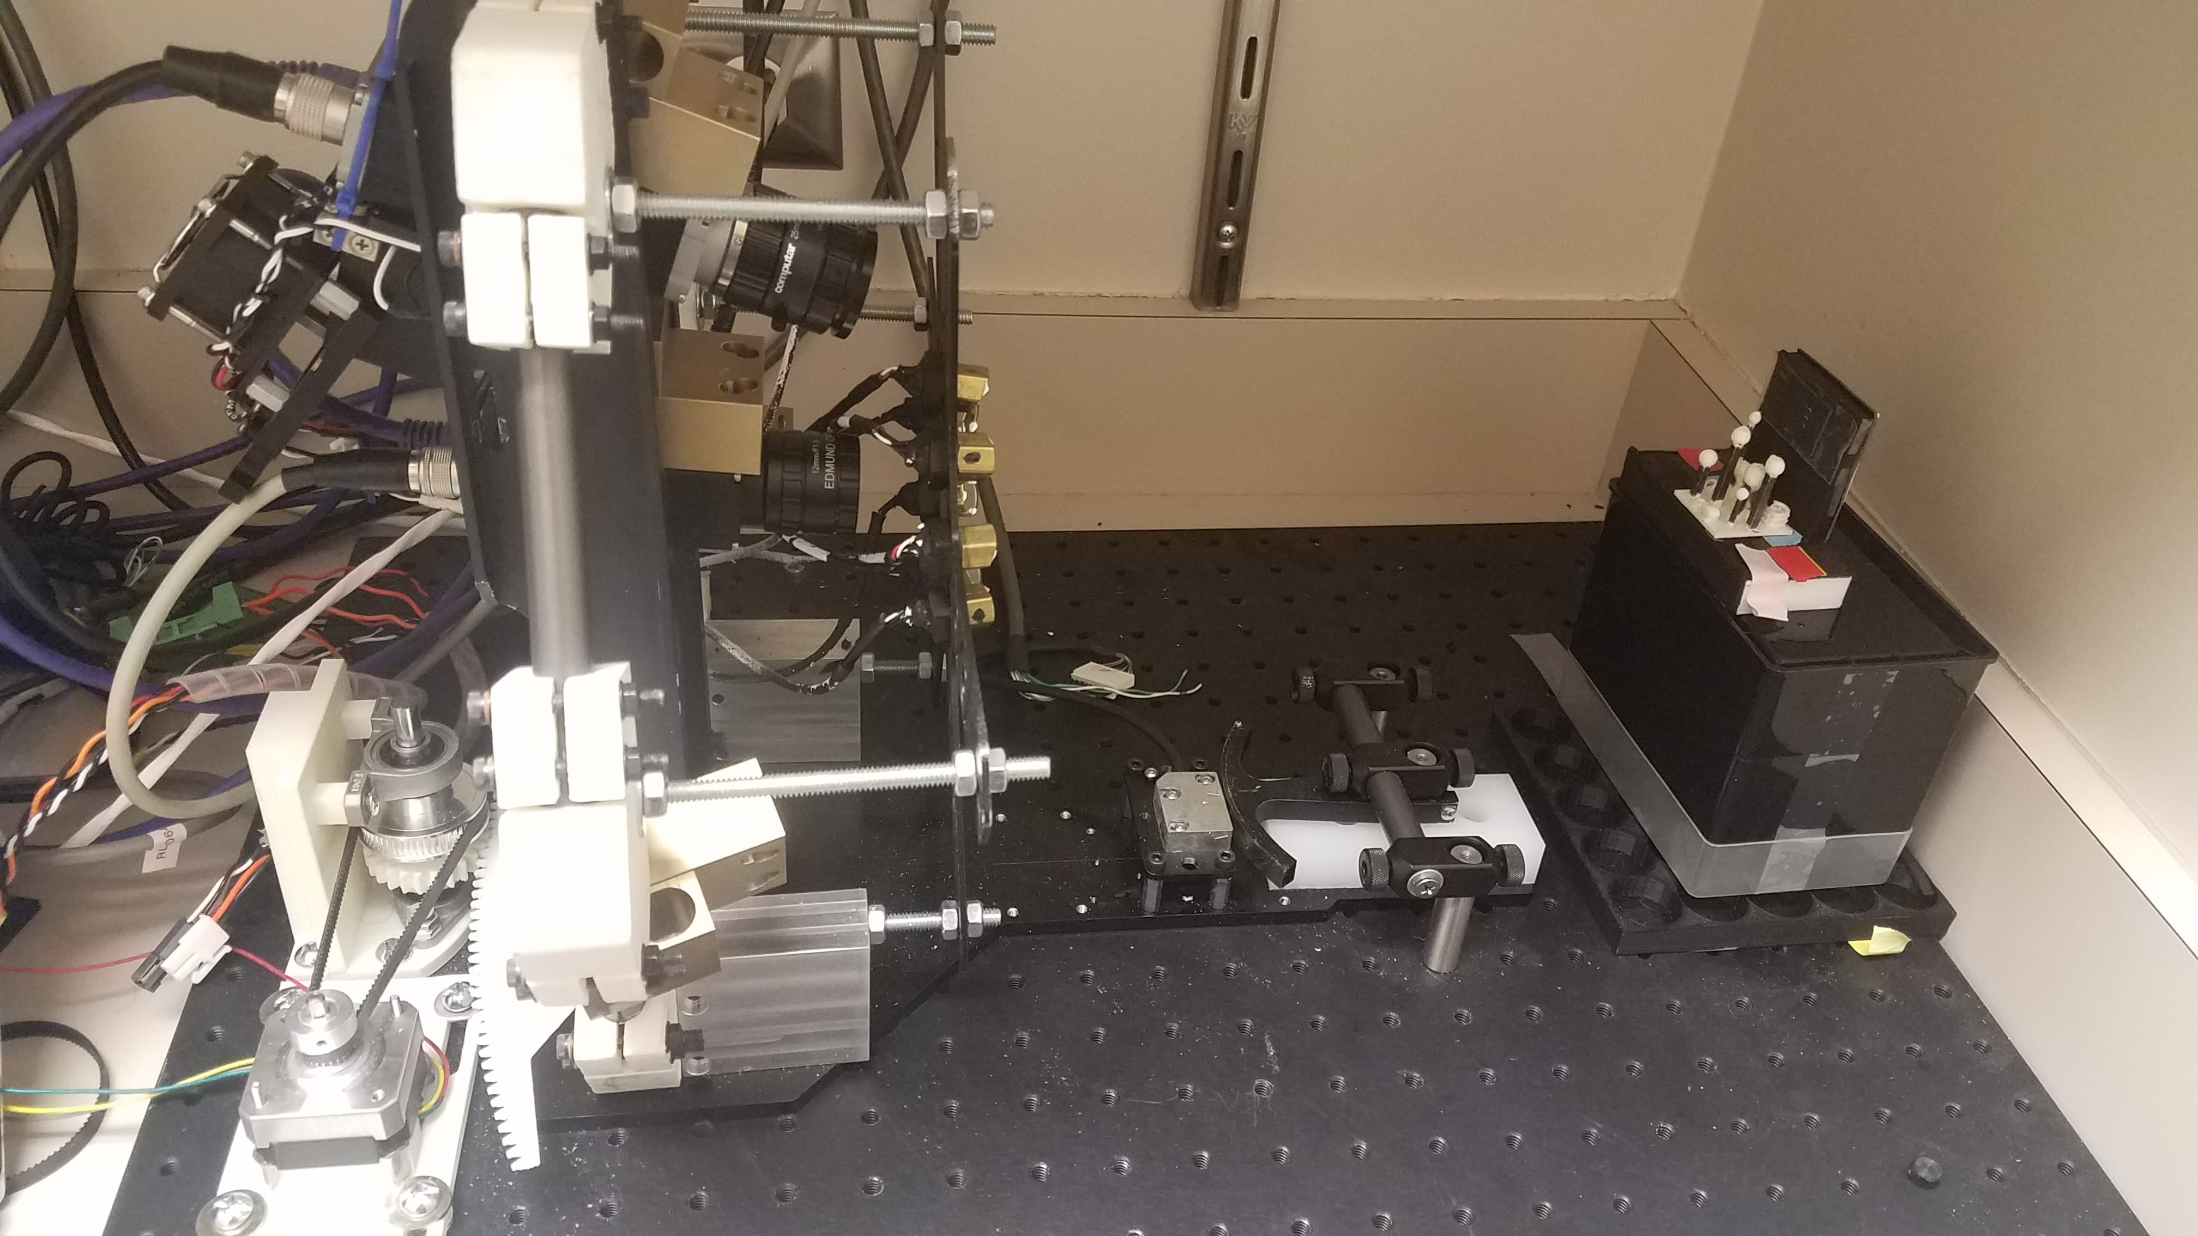
3D Image Reconstruction
Pal Arunachalam

Slide 2
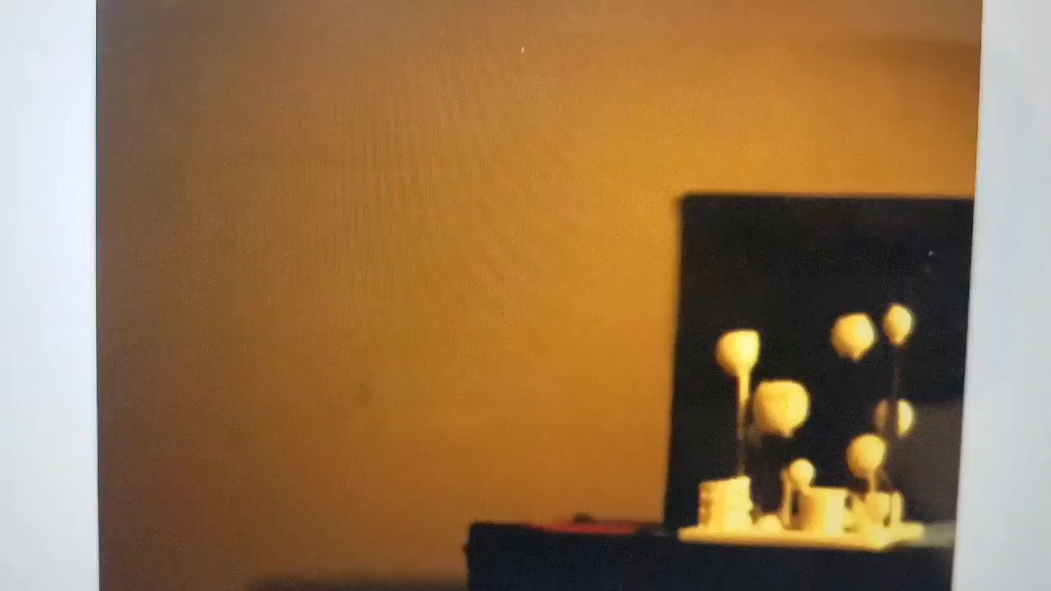
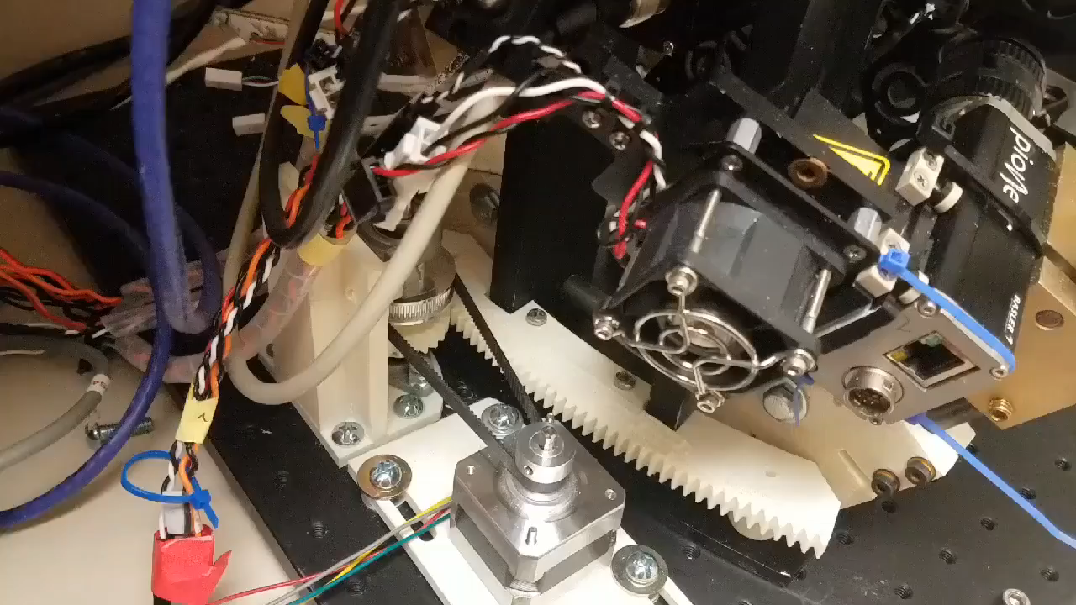
Overview
Device captures 2D images at degree intervals
Process images for 3D Reconstruction via CNN
64 Images Captured Every 0.5 Degrees
Sped Up Image Acquisition

Slide 3
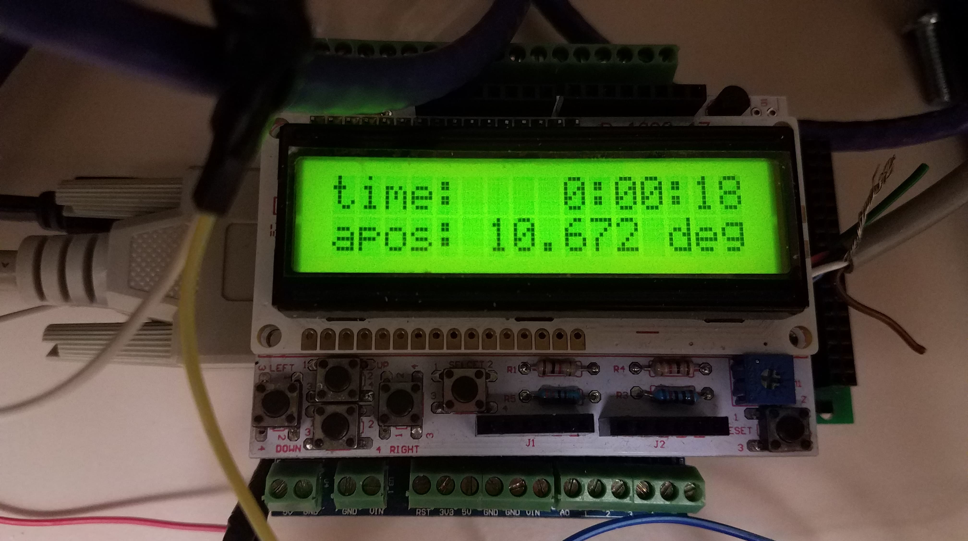
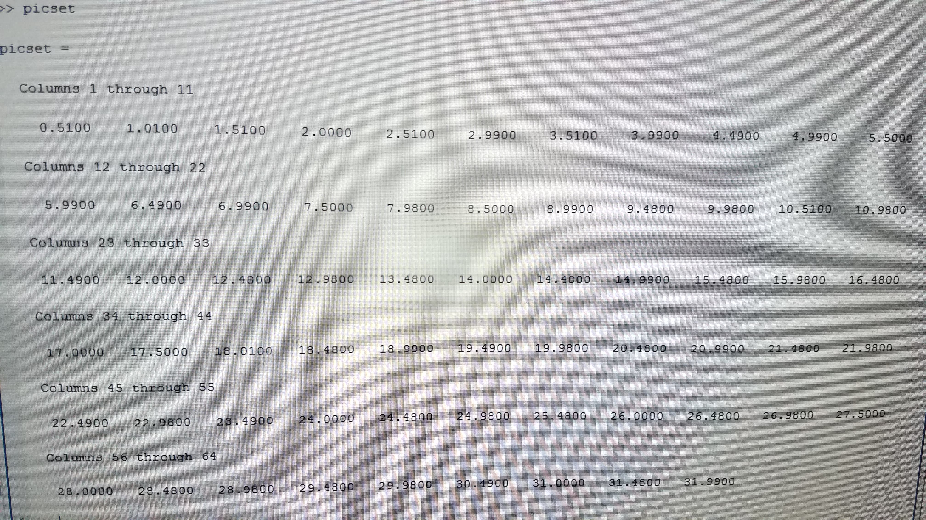
Image Acquisition - Software
2 Arduino Boards – Motor and Encoder
MATLAB captures images from Arduino data
Arduino Encoder Determines Angle
Angle at which Matlab captures an image

Slide 4
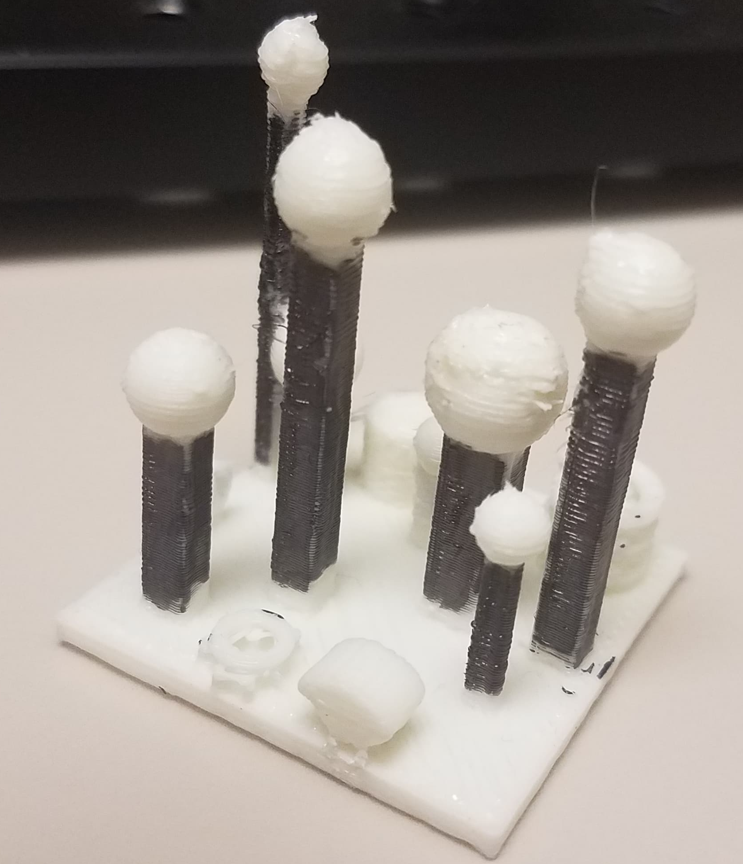
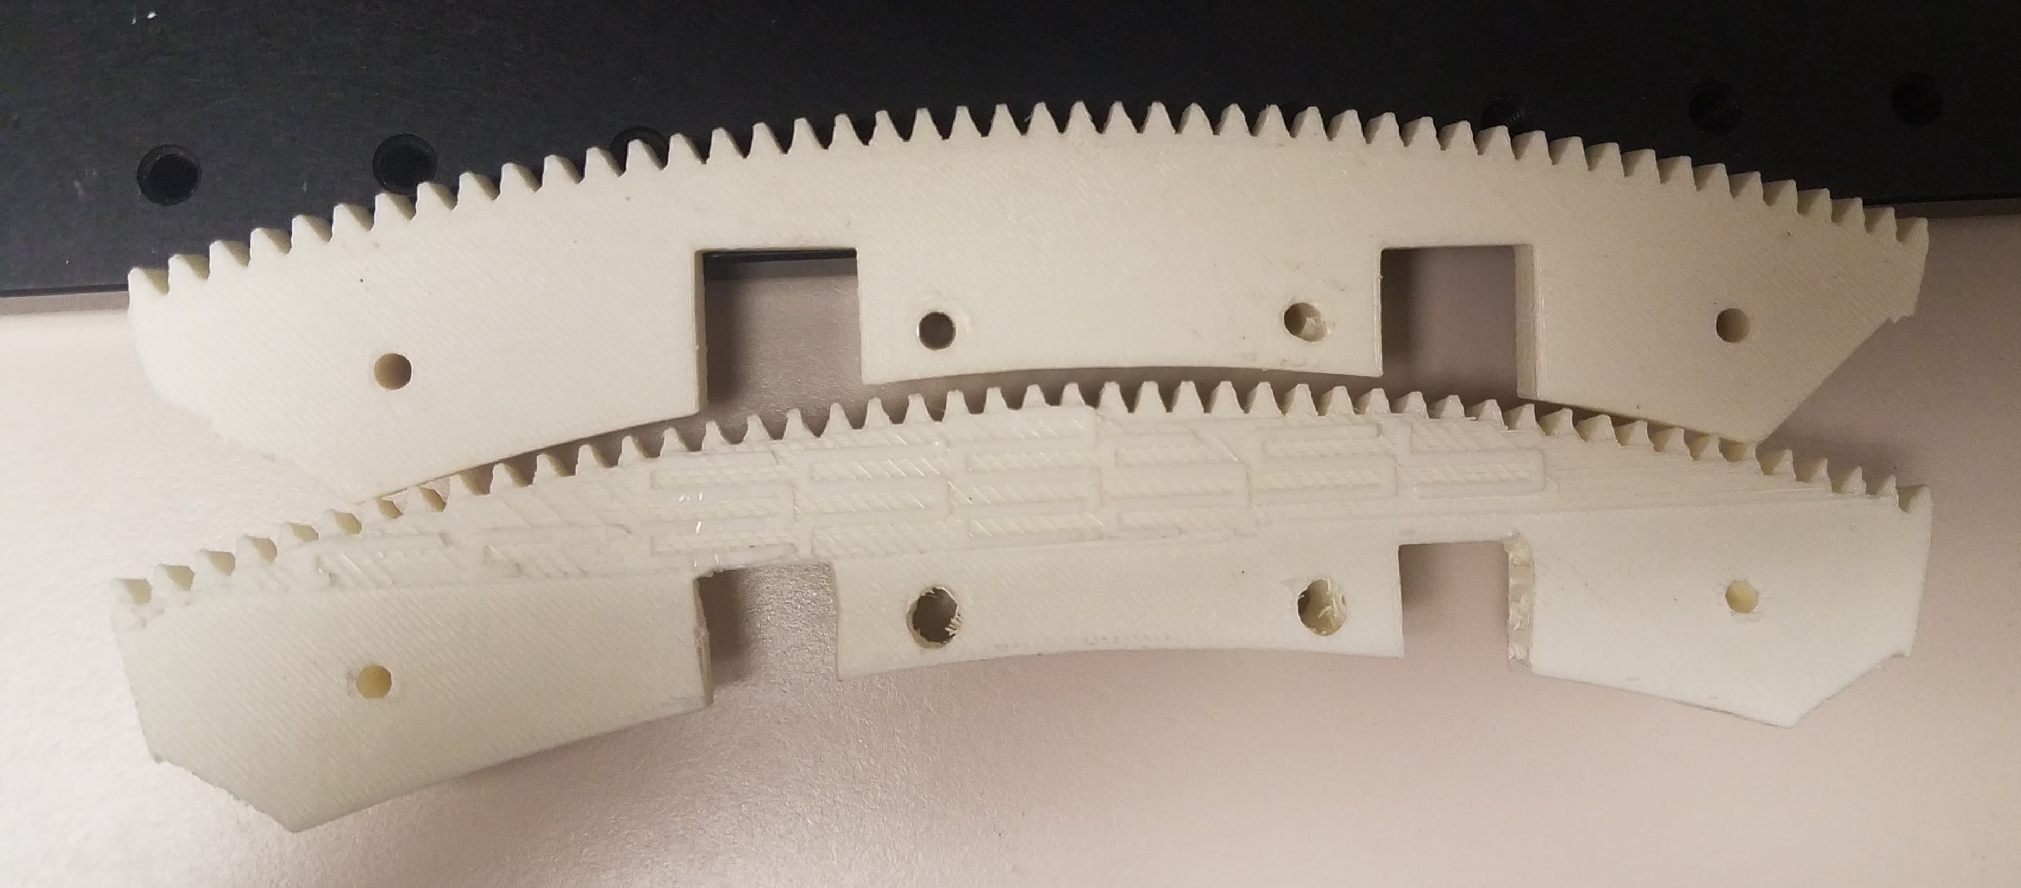
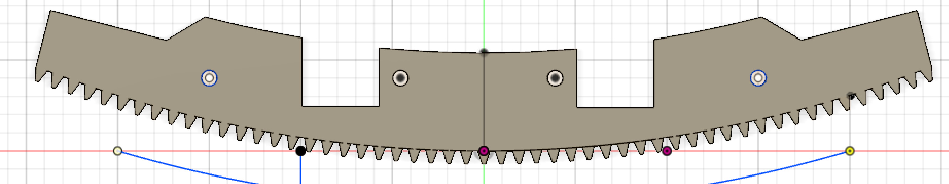
Image Acquisition – Structure
3D models of various components
Gear Structure, Arc, Motor Base, Phantom, etc.
Variations of Arc for smoothness and range
Phantom Test Object
Arc Version 2 (top) and 1 (bottom)
Arc Latest Version – Slightly longer and flatter arc

Slide 5


Image Acquisition - Precision
Initial Model - Image with greatest aggregate error
Somewhat visible checkerboard
Adjusted Model - Image with greatest aggregate error
No visible checkerboard

Slide 6
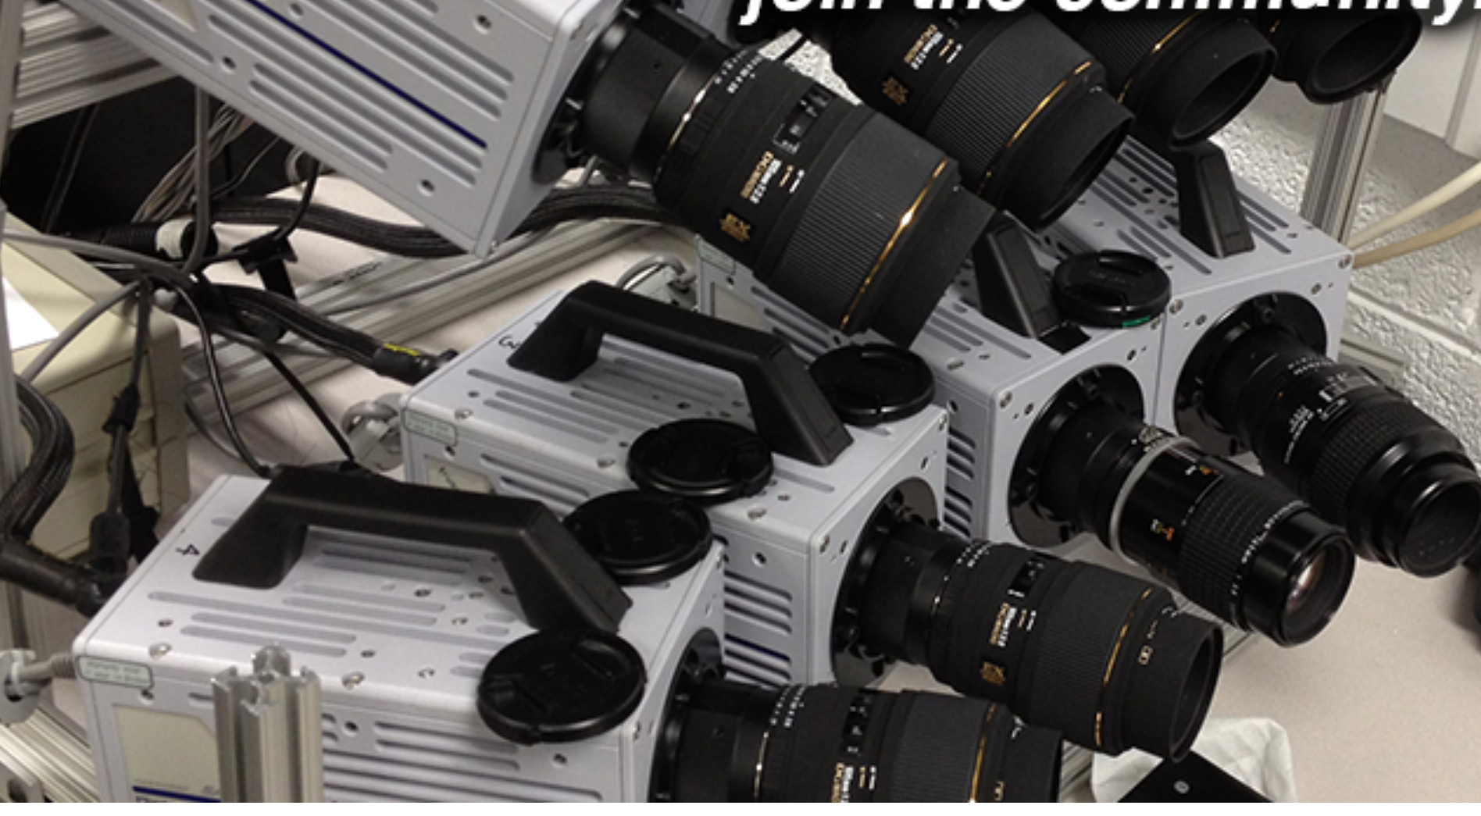
3D Reconstruction – SA Imaging
Previous Reconstruction Method
Synchronized Images from Multiple Viewpoints
Images remapped onto virtual (refocused) planes
Projected images are accumulated and averaged

Slide 7
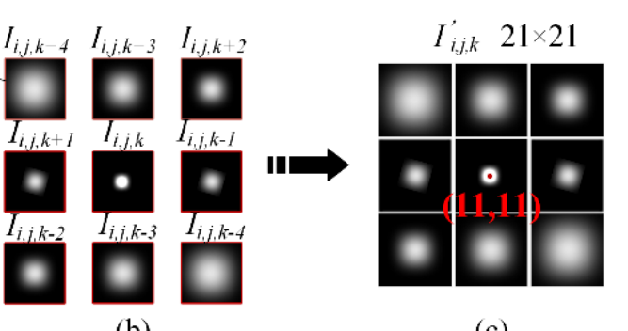
3D Reconstruction – CNN Overview
CNN Objective – Recognize Images with Focused Particles
Determine if combined image has a focused object
Determine corresponding position in image stack
Neighboring 9 images of same particle in different planes

Slide 8
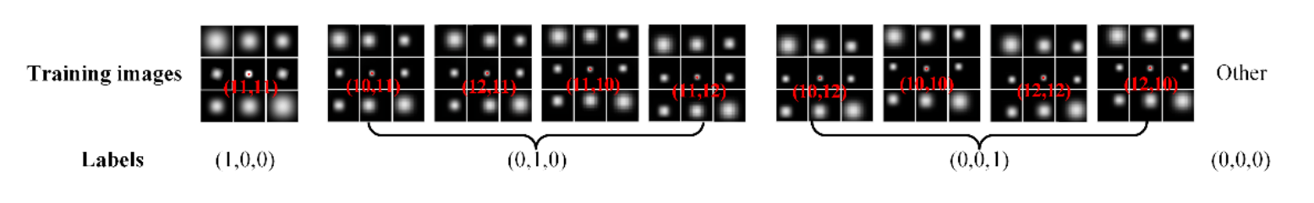
3D Reconstruction - CNN
One Hot Code System
If an output node is ~1, then image contains focused object
SSIM (Structural Similarity) threshold filters unfocused & retains focused
Intensity Center Positions

Slide 9
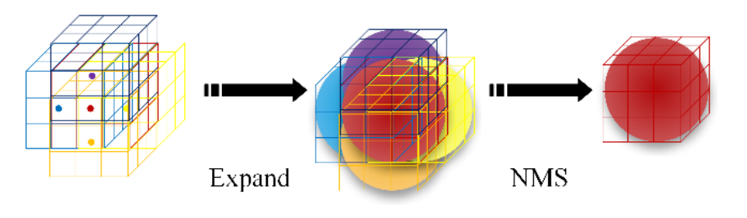
3D Reconstruction – CNN
Training set – Synthetic images with different camera positions and object sizes
Non-Maximum Suppression (NMS) removes redundant overlapping particles

Slide 10
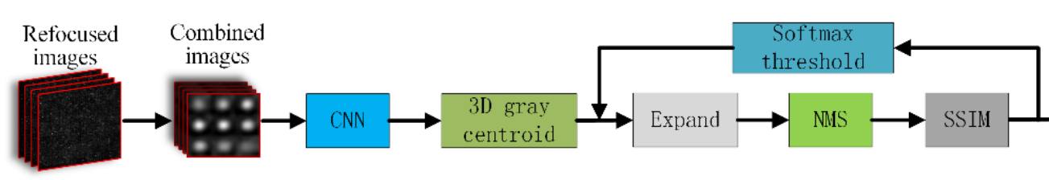
3D Reconstruction - Pipeline
If focused particle – find corresponding position and include in 3D reconstruction

Slide 11
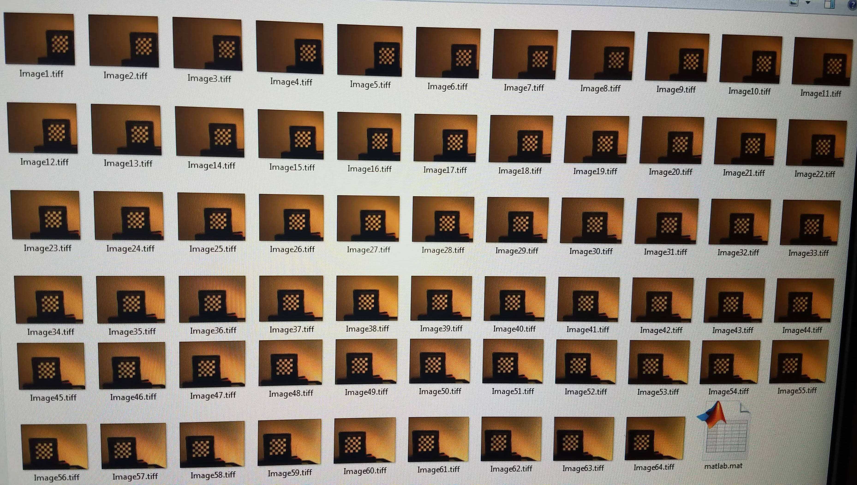
Conclusions
Functionally complete image acquisition process
3D Image Reconstruction
I learned:
MATLAB and Arduino Coding
Designing 3D Models
CNN for Computer Vision
General Problem Solving & Resource Finding

